Slide 1
Project 1-1 group-h
BIM - Factory

Slide 2
How to get started
Step 1
Choosing team roles
Getting organized
Step 3
Getting started
Step 2

Slide 3
1. Choosing team roles
Choosing our moderator
Finding out about the strength of each teamplayer: who can/will focus on what:
- Programmimg
- Designing
- Researching
- Presenting
Etc.

Slide 4
2. Getting organized
Creating a new repository on github and adding all collaborators
Deciding on communication methods – creating a whatsapp-group, daily to-do-meetings and progress meetings
Deciding on using trello – creating an account – creating a trello-board for our tasks, progress management and success
Deciding on To-do‘s , goals- what do we want to achieve, non-goals – what do we not want to have and splitting the tasks into small to do‘s
Tasks – splitting – choosing who is going to work on which part

Slide 5
3. Getting started
Methods are clear
Tasks are clear
Roles are clear
Everybody start to work on his chosen task
Progress meeting after some hours
Getting prepared for the meeting with the client – question collection
Meeting with the client – getting a very clear idea of what our client want to have

Slide 6
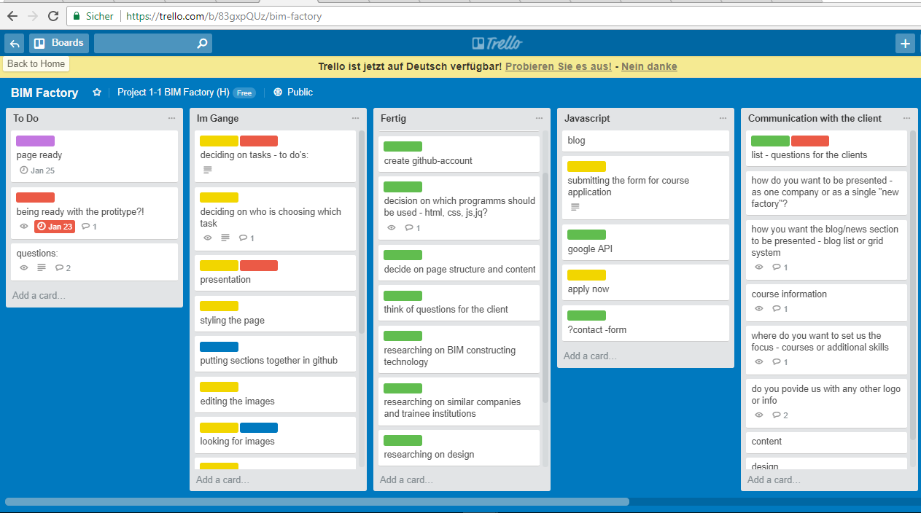
Work in progress
Daily meetings
Documentation in trello for progress measurement
Daily considerations of todo‘s and splitting the tasks
Coming back to the client
Developing a prototype

Slide 7
Getting back together
Constant communication (meetings) and research (images & other pages)
Organizing how to merge the different sections we were working on together – pulling and pushing on github
Reorganizing the team – new tasks – new teamroles
Getting together for the styling and more ideas
Splitting the tasks again
Debugging
Documentation of the workflow

Slide 8

Problems we faced & LEARNING process
Getting back together-suprises – using different bootstrap links
Difficulties with different designs – streched items versus cards etc.
Next time: even more planing –
Deciding on exactly which links will be used
drawing/designing our own template more precise before getting started

Slide 9

Final sprint – fulfilling the goal
Final meeting
Deciding on and applying the final styling
Final coding
Getting ready for the presentation
Deciding on who and who is going to present
Presentation

Slide 10
Thank you for your attention Happy Coding THE END

